Slide 1

Seoul bike Rental
Yu Haoyang, yue han, juntao guo

Slide 2

Background
Requirement for more rental bicycles for mobility comfort
Need for stable supply of rental bicycles

Slide 3

Purpose
按一下以新增文字
Find and create a model to predict the bike count required for a stable supply of rental bikes​
What factors affect the bike count rented at that hour, thus what factors can help predict bike count needed?​

Slide 4
Procedure
Multicollinearity
Clean Data
Model Selection
Model Diagnosis
Influential Points
Conclusion
Exploratory Data Analysis

Slide 5
Exploratory Data Analysis

Slide 6
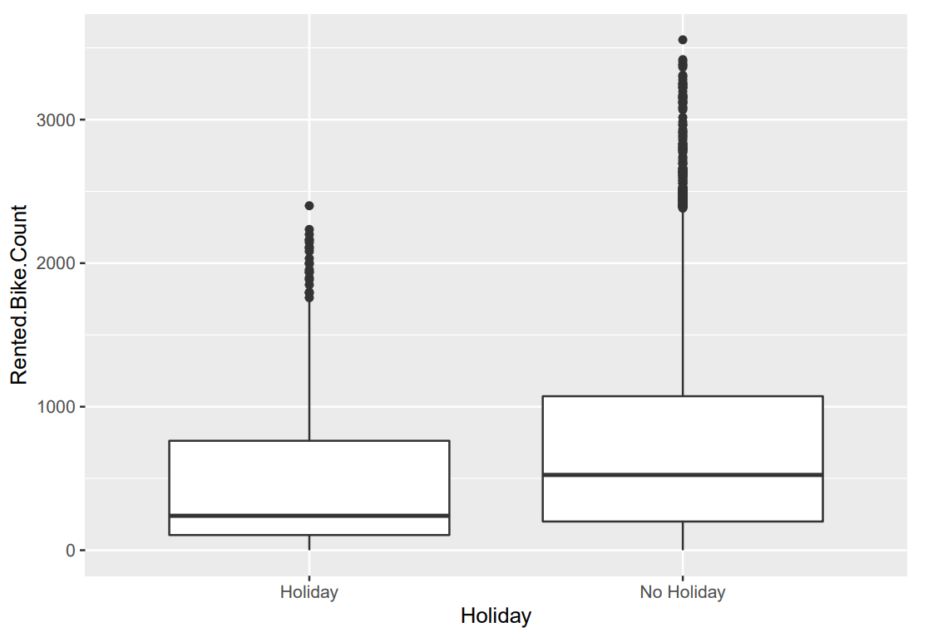
HOLIDAY
It is common sense that people are more likely to stay at home or drive long distance during the holidays
So, Will the holiday have an impact on the number of bicycle needed?

Slide 7
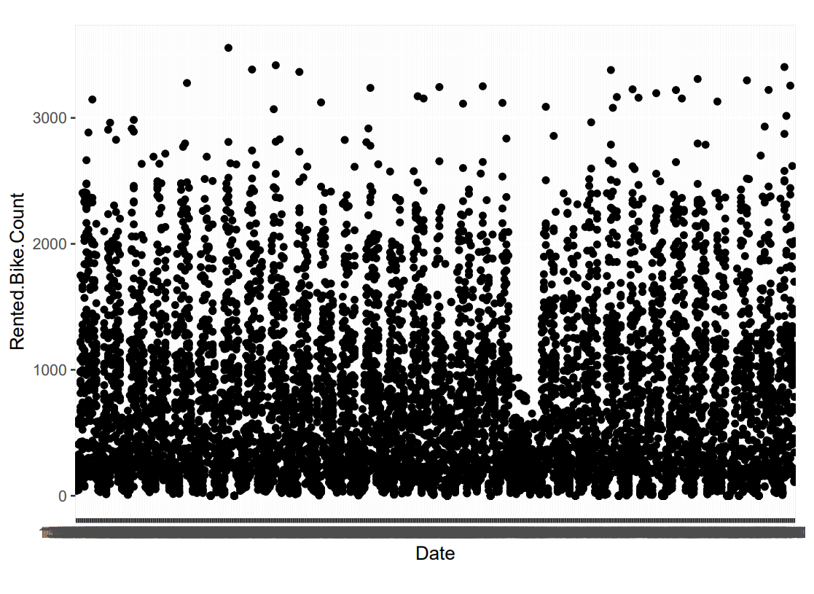
Time Of Year （date)
Does the time of year affect the bicycle needed?

Slide 8

Model Selection

Slide 9
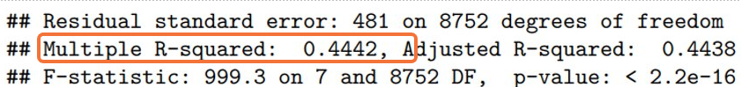
Model 1 & 2
Model 1:
holiday, seasons, temperature, rainfall, hour
Model 2:
All given variable instead of date.

Slide 10
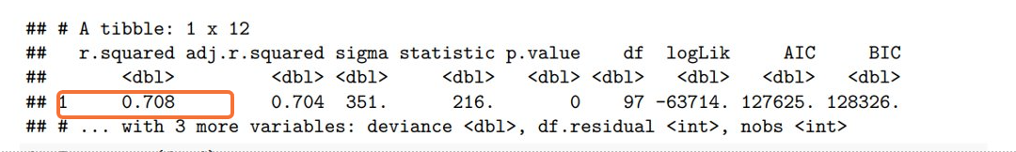
Model 3
Interaction for the variable in model 2

Slide 11
Forward
Backward
Stepwise
Which variable can be balance between loss of predictability and theoretical simplicity?

Slide 12
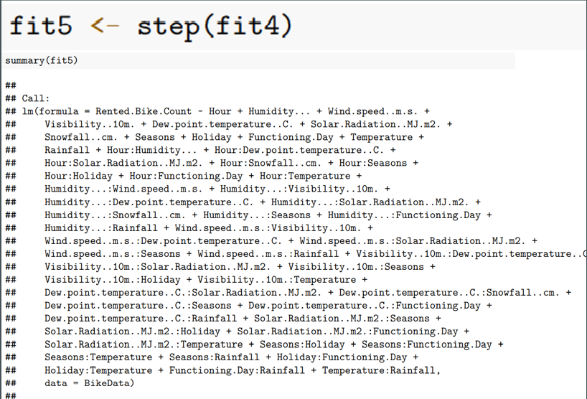
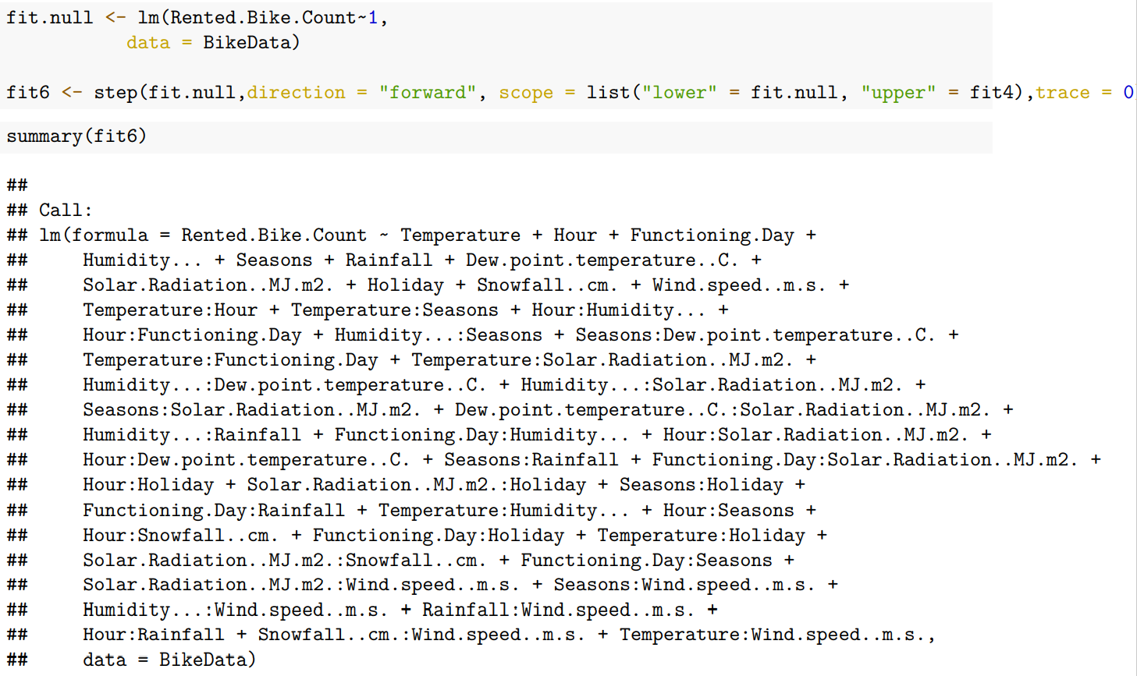
Model 5 model 6 backward elimination forward selection

Slide 13
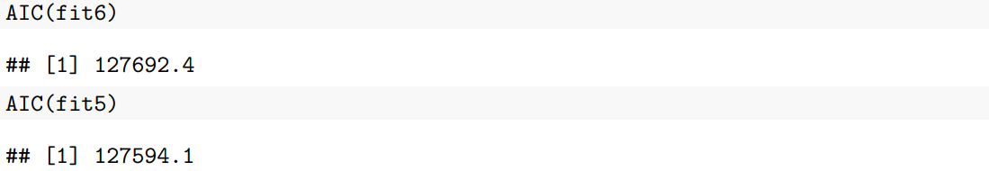
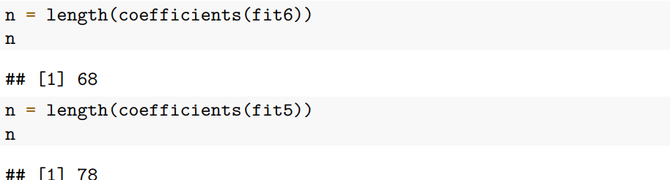
Predictability & simplicity

Slide 14
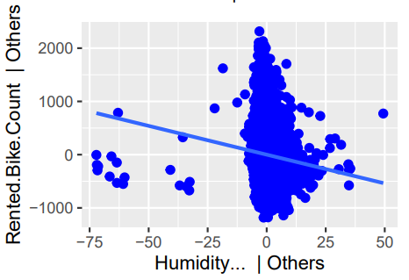
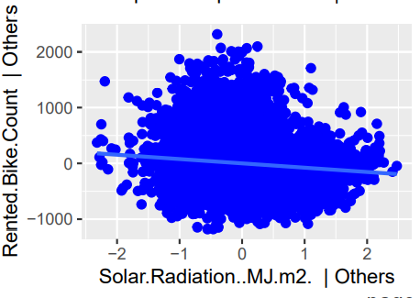
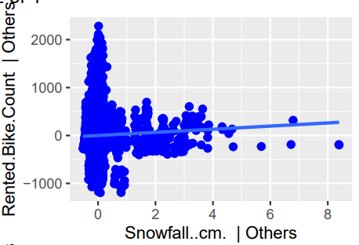
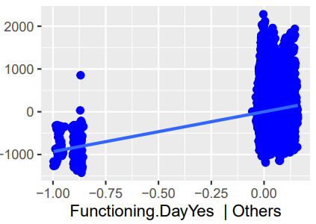
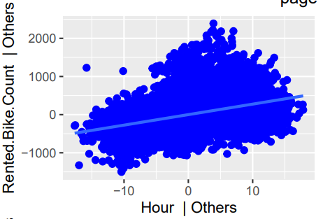
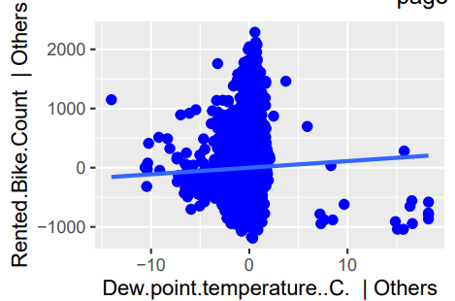
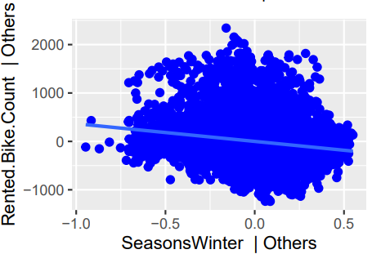
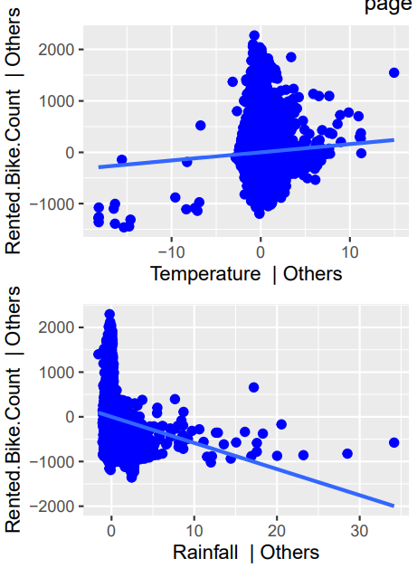
Model Diagnosis
Variable plot of all main effects shows adding will improve our fit since they show trends

Slide 15
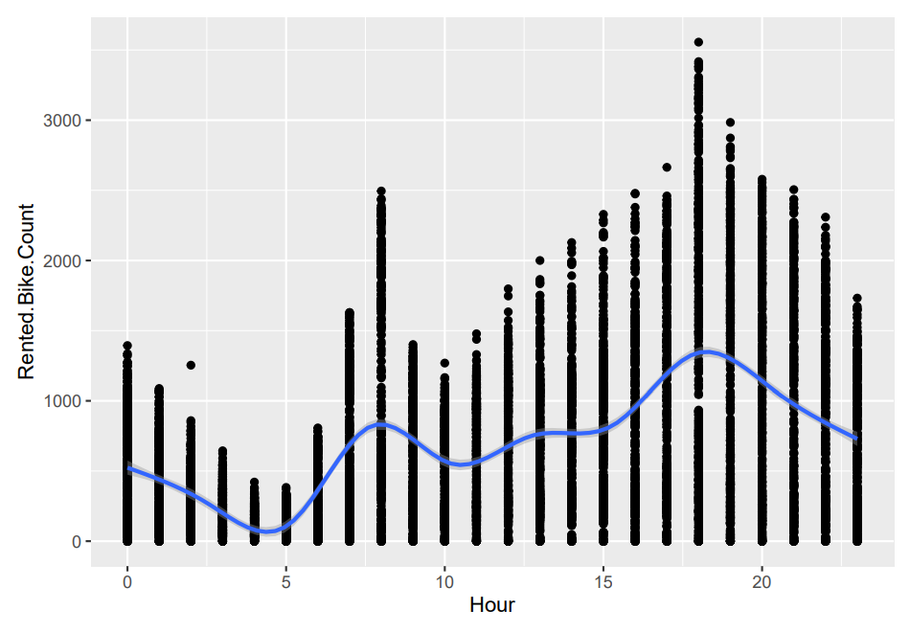
Model Validation
Model-Building Dataset
Training Set
Validation Dataset
Testing Set

Slide 16
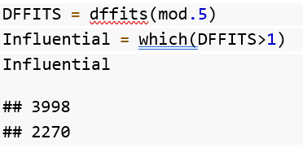
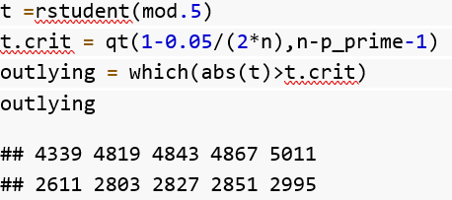
Influential Observations
Cook’s Distance
We can find that
2257, 3998, 5133, 5753, 5035, 8230, 8233
are seemingly influential points.
DFFITS
We can find one influential point
Deleted Studentized Residuals
We find 5 influential points

Slide 17
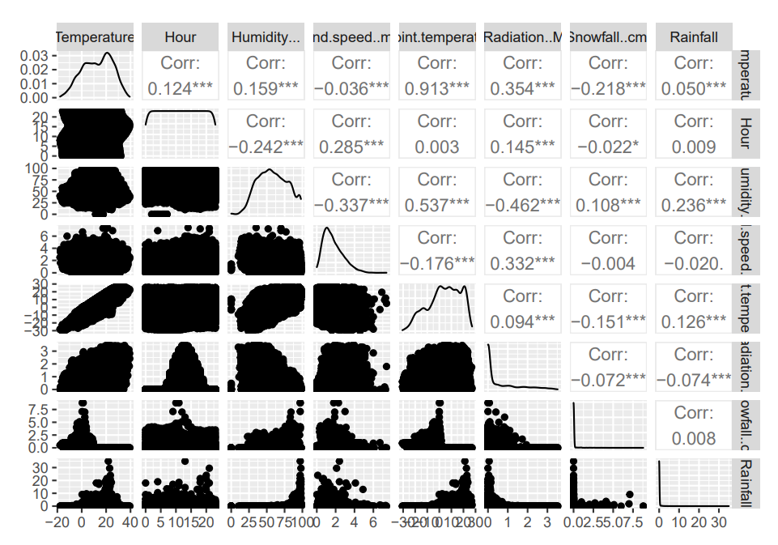
Correlations
High correlation between temperature and Dew.Point.Temperature which is an indication of multicollinearity

Slide 18
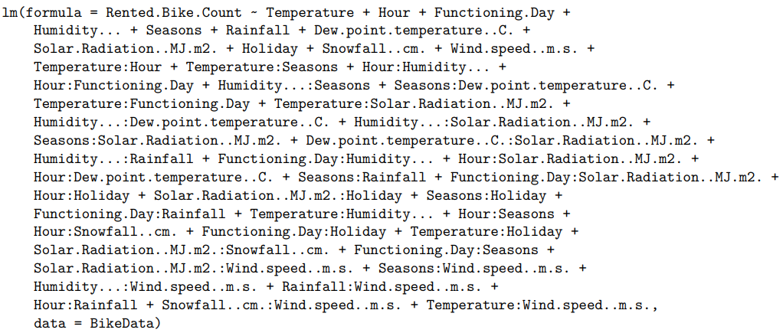
Conclusion
Can predict how many bikes are rented per hour
We can then use this to give a stable and appropriate supply of rental bikes
A limitation we had was humidity and the outliers we suggest to record humidity in more detail, especially the range humidity variation and further research
In addition future research can be made about factors such as covid cases that could be relevant currently

Slide 19
References
UCI Machine Learning Repository. (2020). Seoul Bike Sharing Demand Data Set [Data set].https://archive.ics .uci.edu/ml/datasets/Seoul+Bike+Sharing+Demand

Slide 20


Thank You for listening ☺

